Slide 1


Experiment 10a
Wye-Wye Transformer – 4 wire
Solidly Grounded System
Unbalanced Load and Ground Fault
Dr. Norbert Doerry and Dr. John V. Amy Jr.
http://doerry.org/norbert/MarineElectricalPowerSystems/index.htm
© 2024 by Norbert Doerry and John Amy
This work is licensed via: CC BY 4.0 (https://creativecommons.org/)

Slide 2

Schematic
$$V_{secondary_ll}=\frac{1}{2}V_{primary}=\frac{1}{2}208=104 volts rms (147 V peak)$$
$I_{secondary}=nI_{primary }$
(Neglecting losses)
C_{p} = 2.2 µF
R = 1200 Ω
R_{L} = 300 Ω
R_{La} = 200 - 300 Ω
R_{lamp} = 450 Ω
N = 2
R_{G} = 400 Ω
R_{lamp}
Common Mode Current Probe
Current Meter (all phases)
Voltage Meter (all phases)

Slide 3
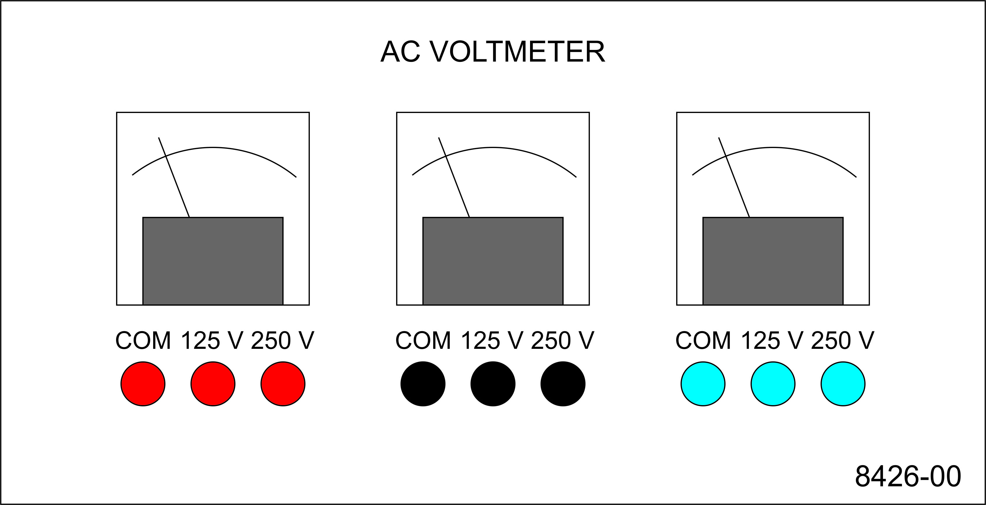
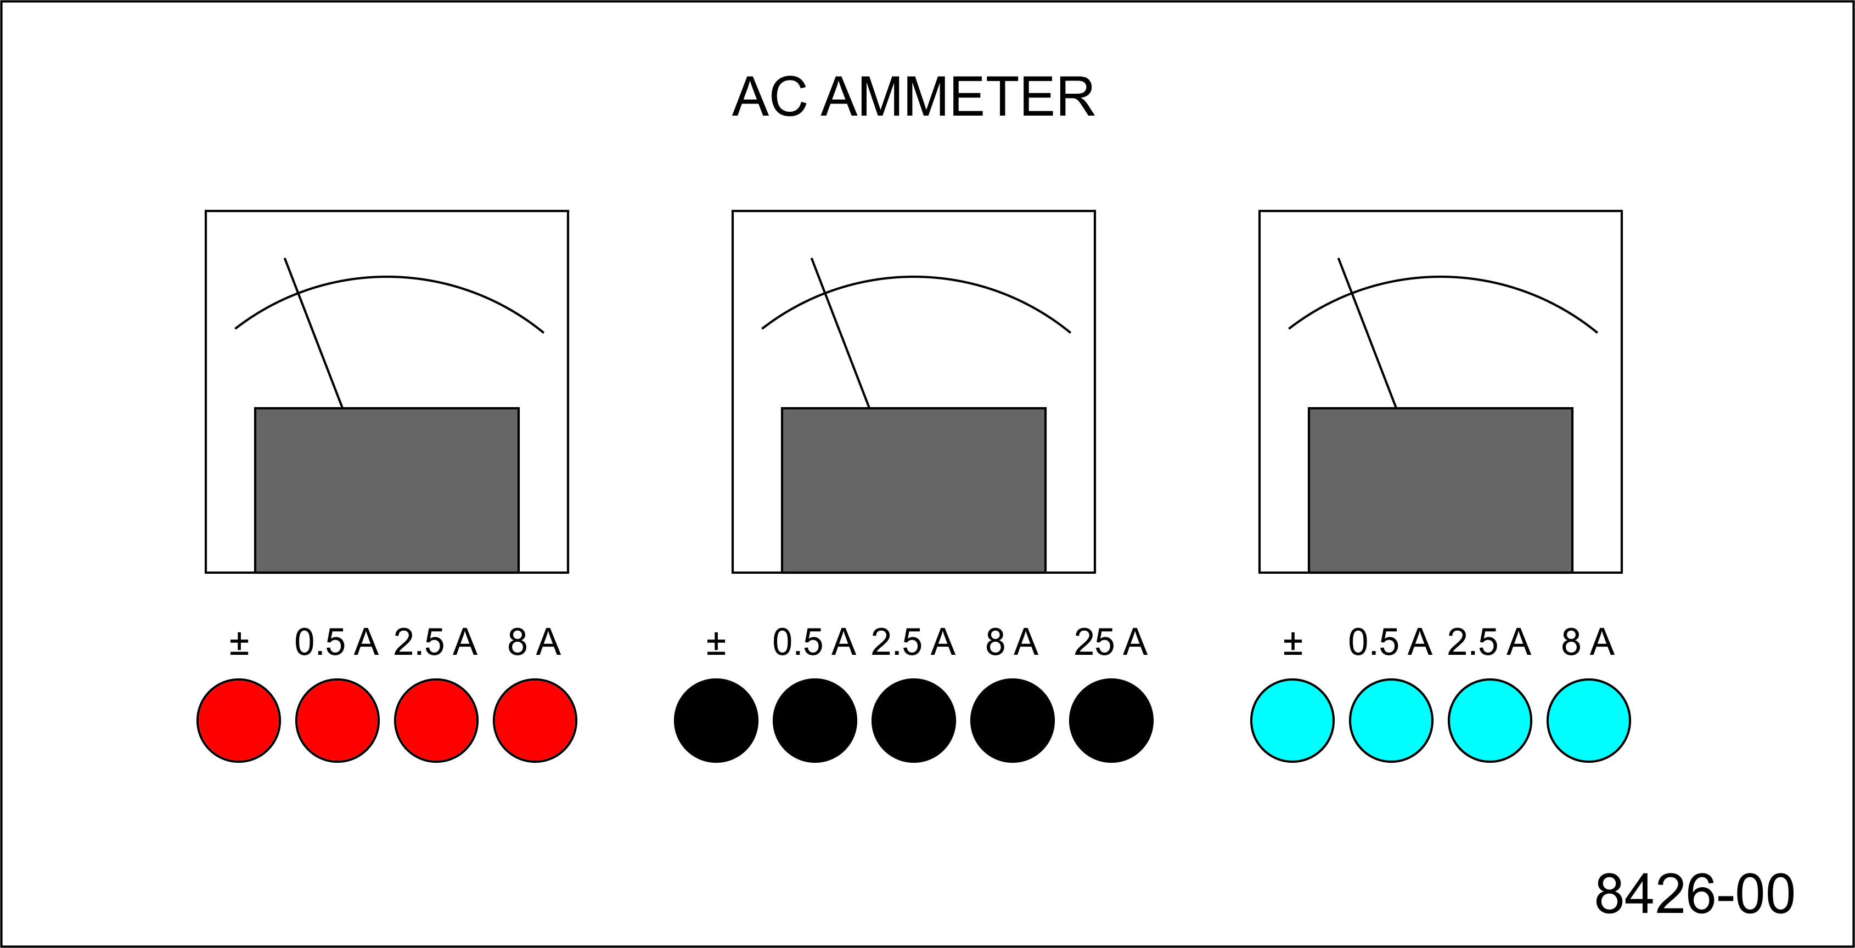
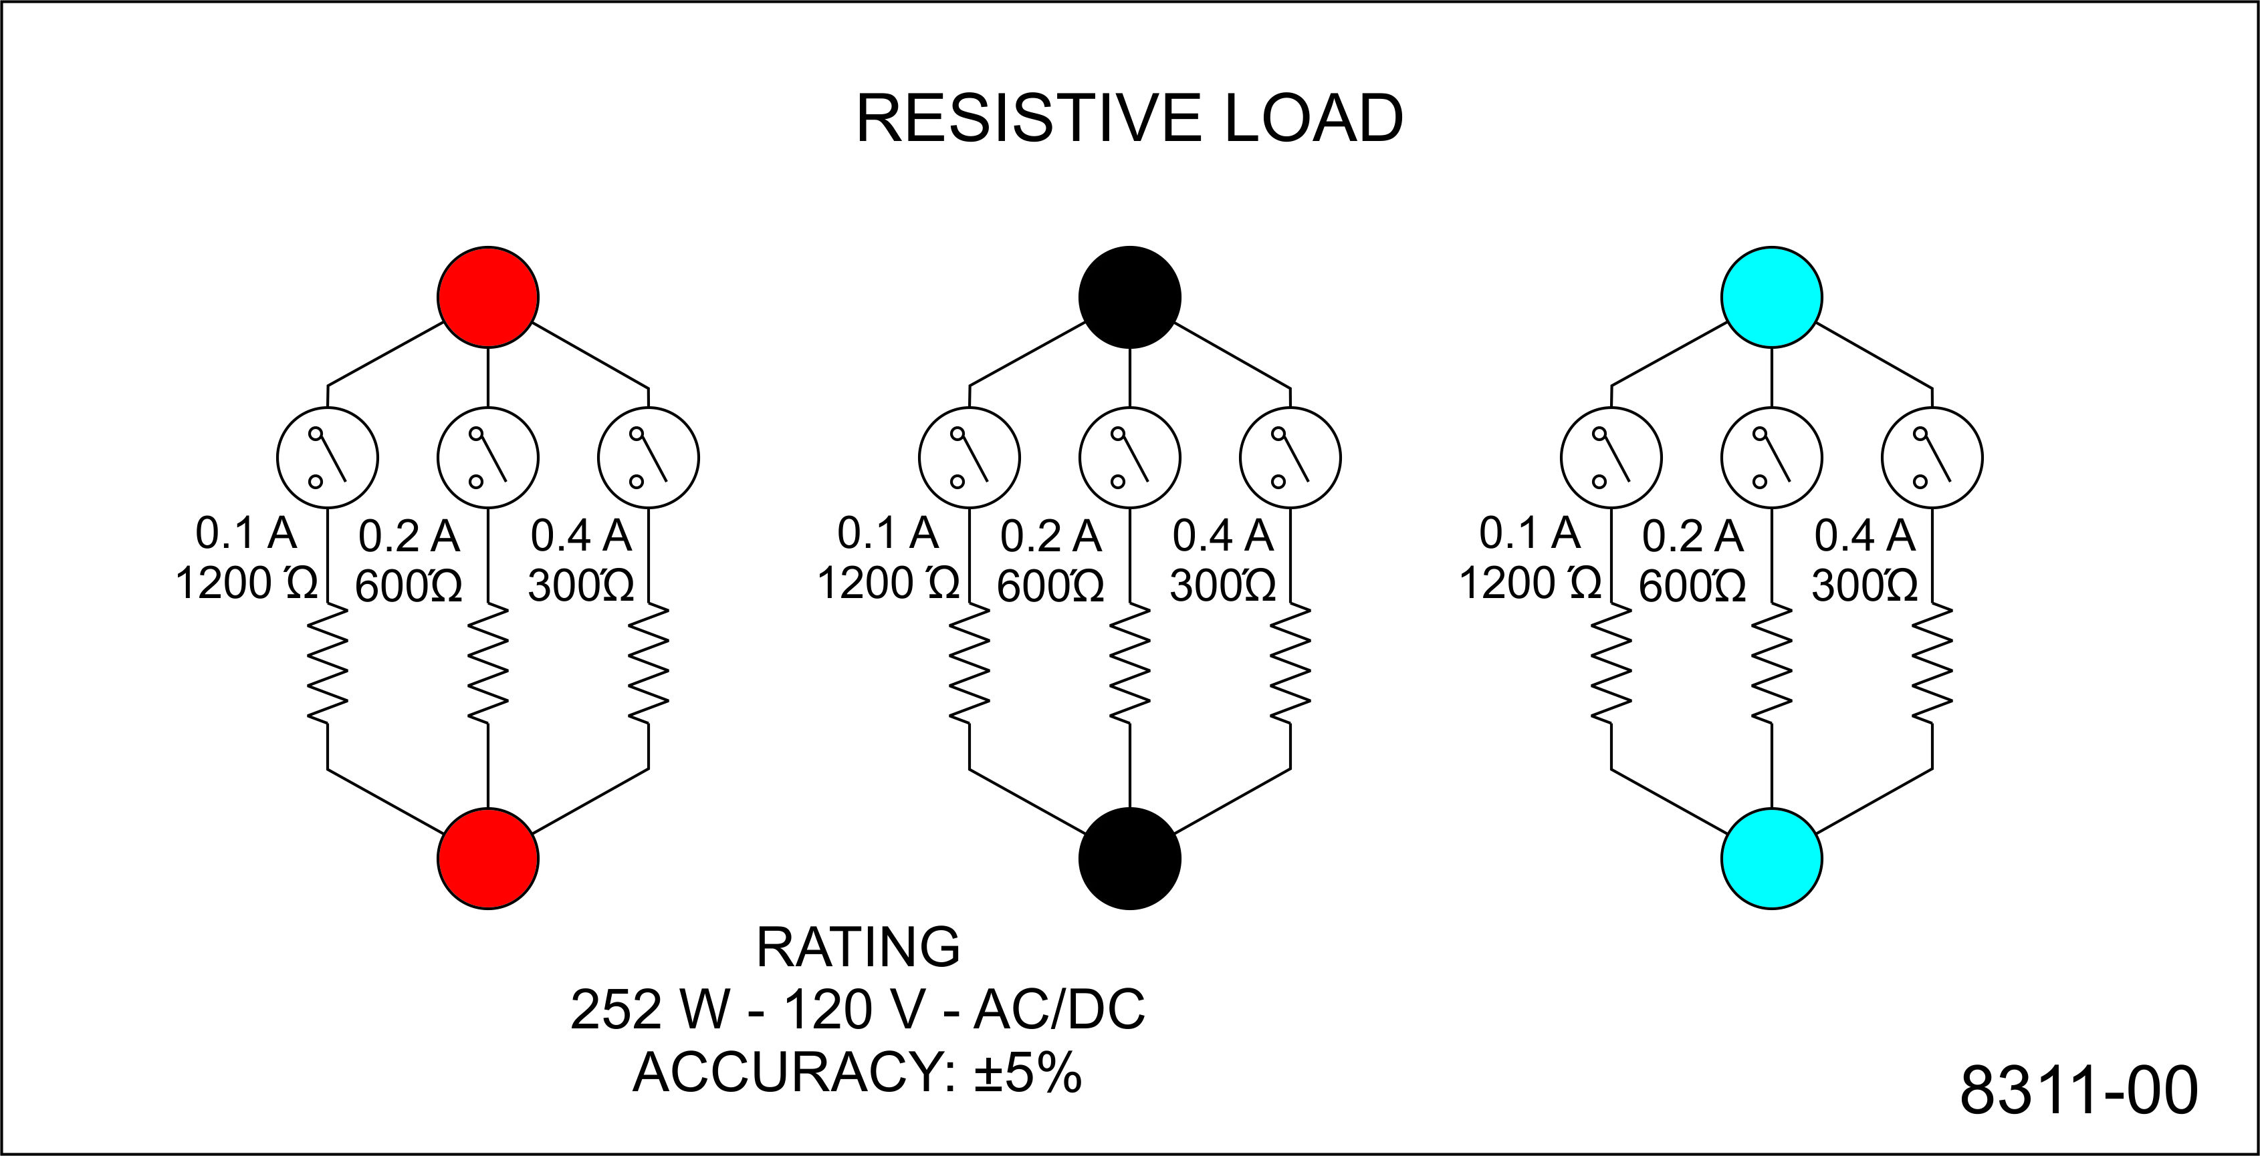
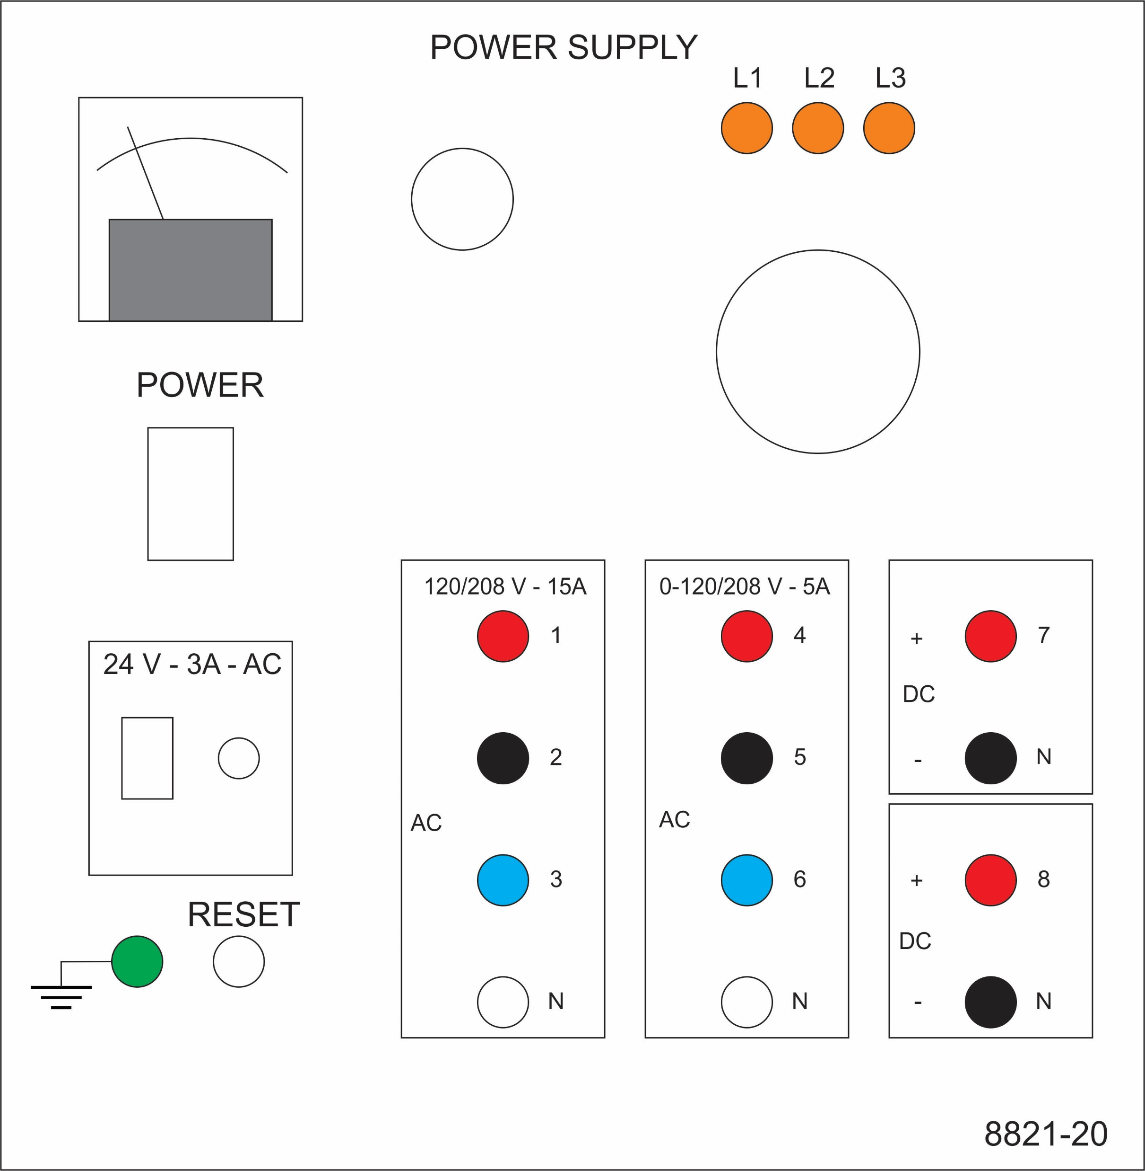
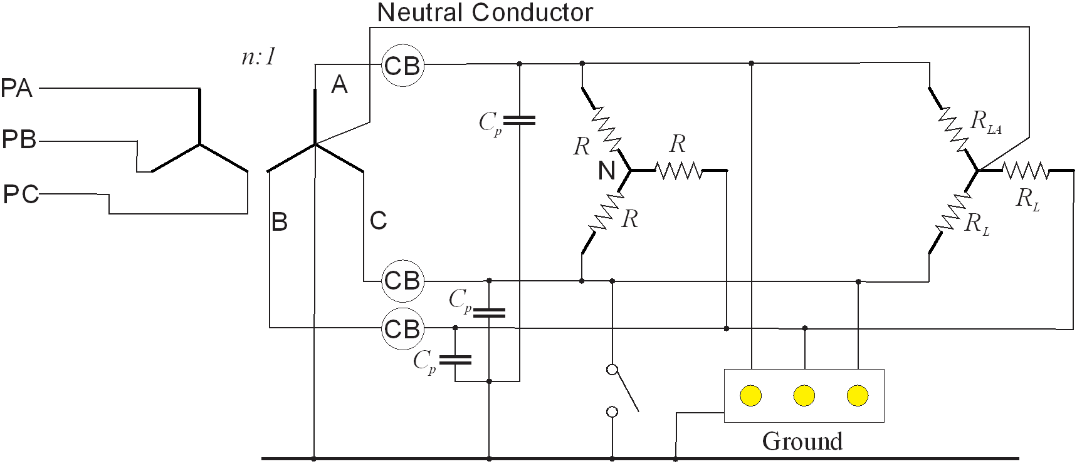
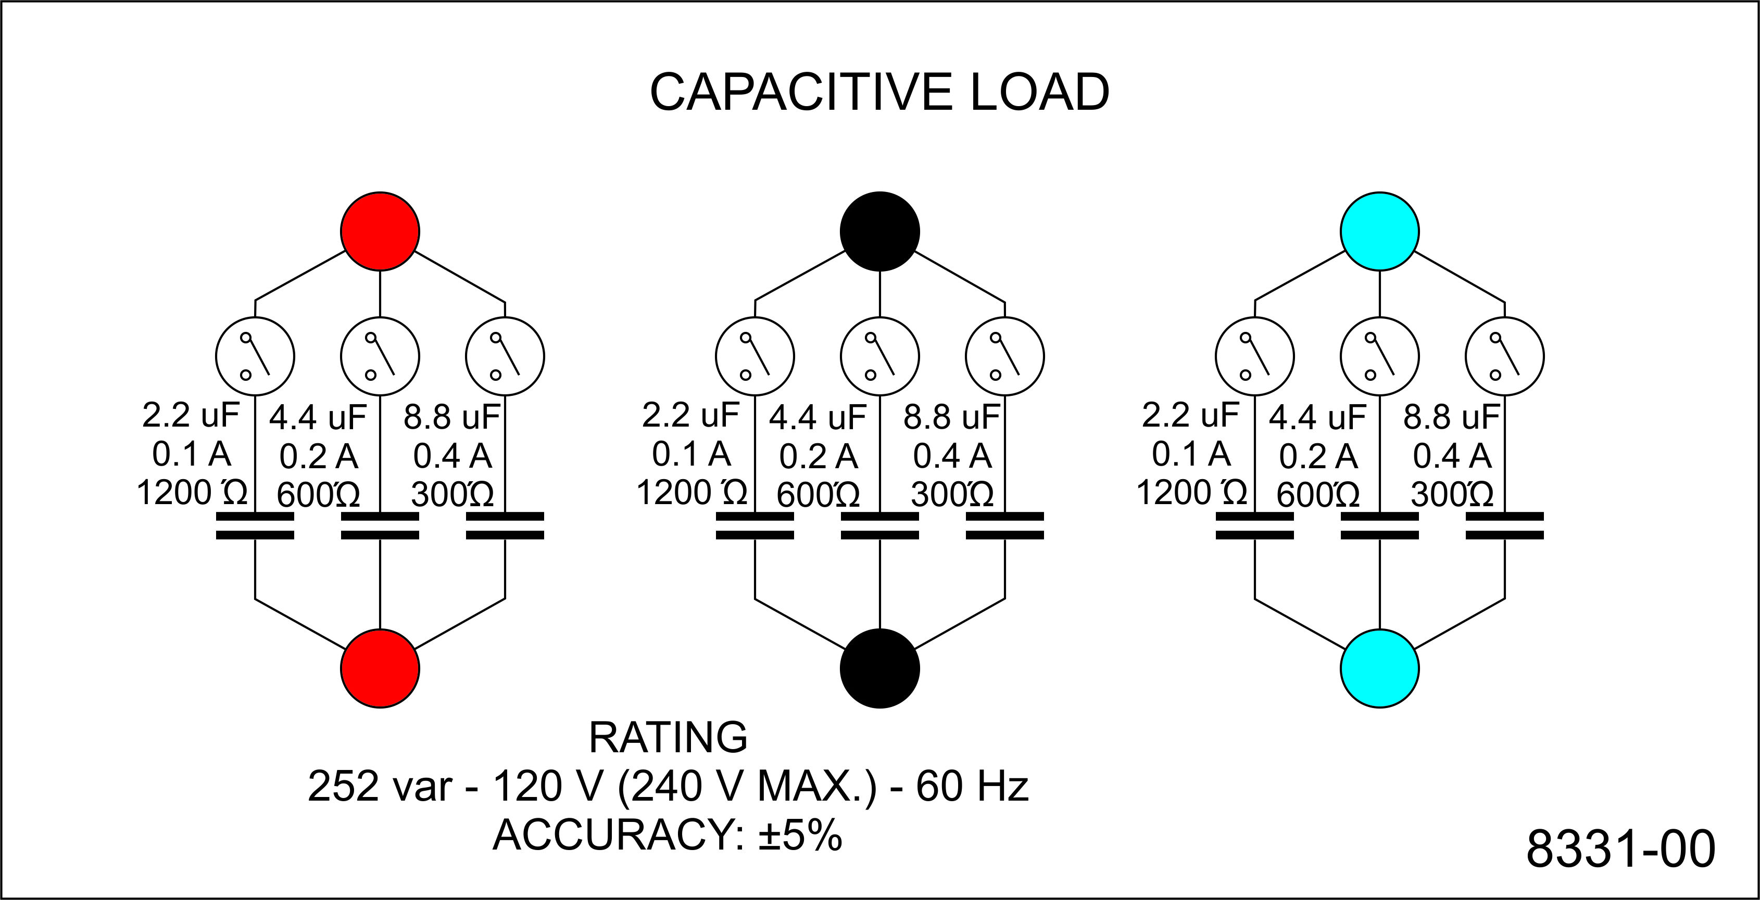
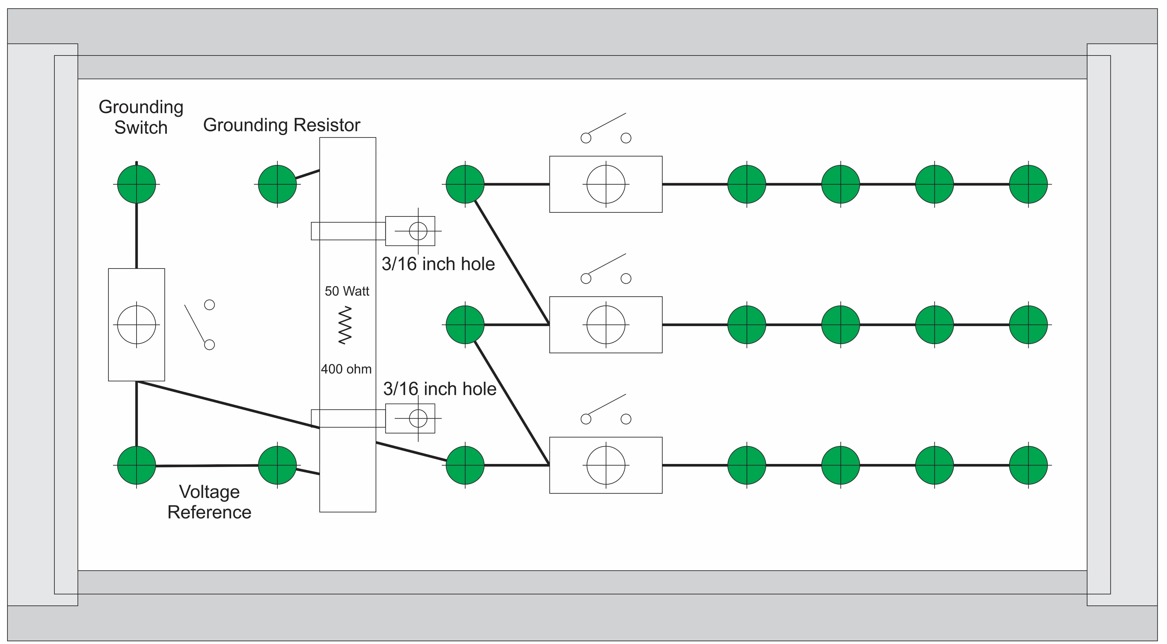
Experiment 10
Secondary - LL
Secondary - LN
Secondary - LG
Primary line
Secondary line
Load line
Wye
Wye-Load
Parasitic

Slide 4
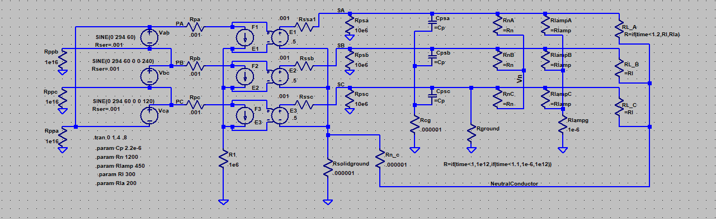
Simulation Model
LTspice
20241029 experiment 10a.asc

Slide 5
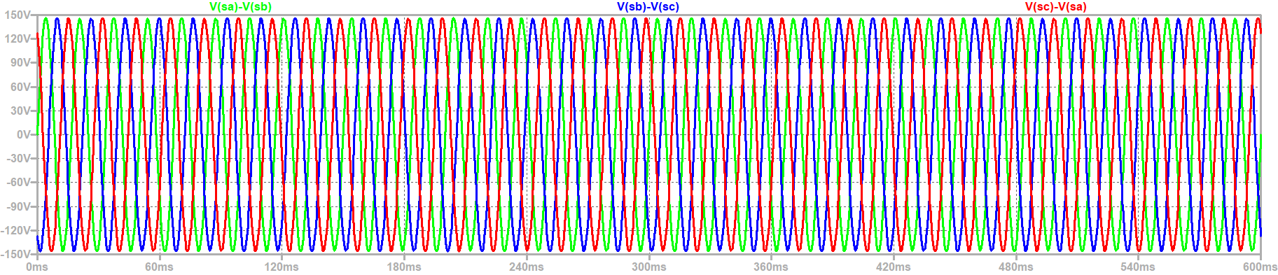
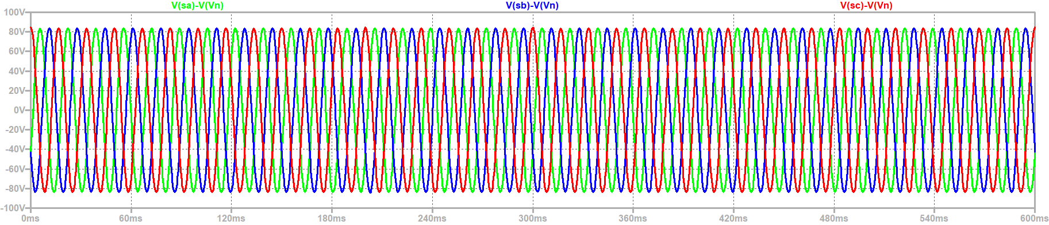
Steady State Voltages – Ground Fault /
Unbalanced Load
$$V_{secondary_ll}=\frac{1}{n}V_{primary}=\frac{1}{2}208=104 V rms (147 V peak)$$
Secondary Line to neutral Voltage: 60 V rms (85 V peak)
Ground Fault
Unbalanced Load

Slide 6
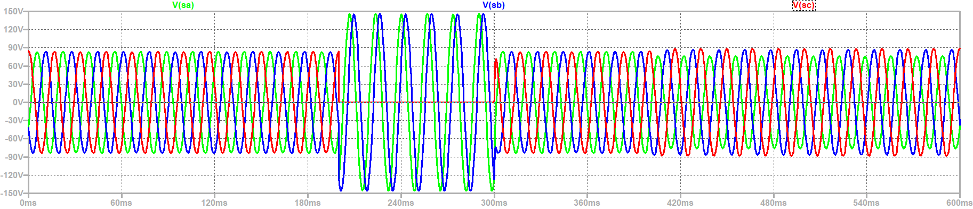
Steady State line to ground Voltages – Ground Fault / Unbalanced Load
Loads on unfaulted phases experience 73% overvoltage during ground fault
Ground Fault
Unbalanced Load

Slide 7
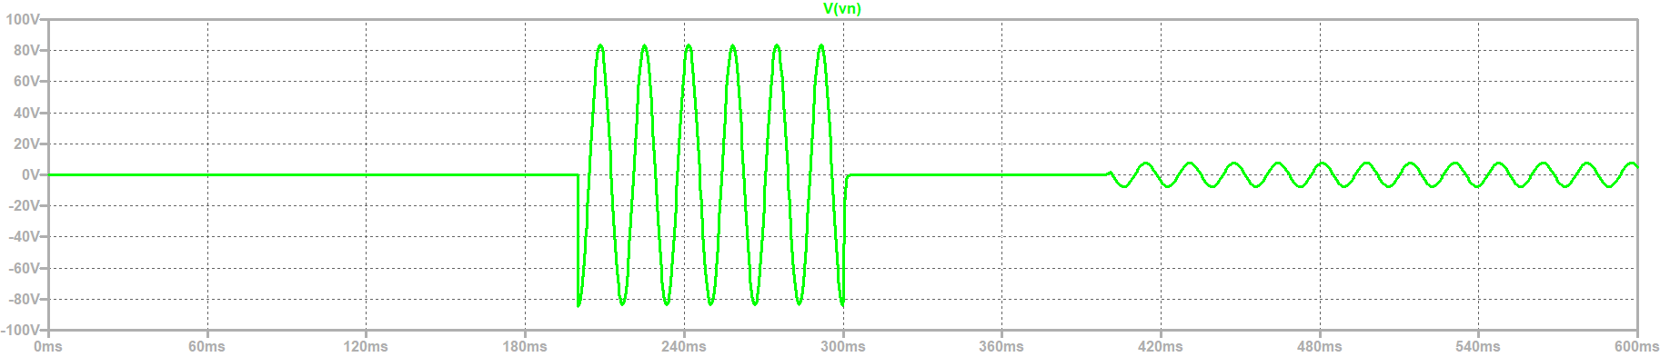
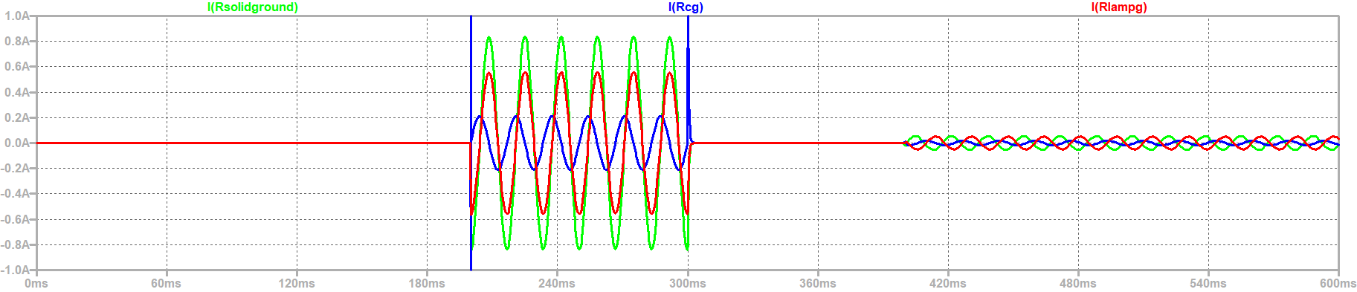
Neutral to ground voltage
(CM Voltage) and CM Current through Parasitic Capacitances, lamp resistances, and grounding resistor
Neutral to Ground Voltage
Ground Fault
Unbalanced Load
CM Current through Parasitic Capacitances, Lamp Resistors, and Ground Connection

Slide 8
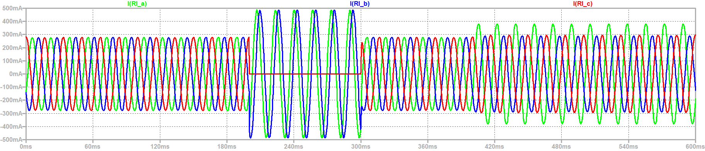
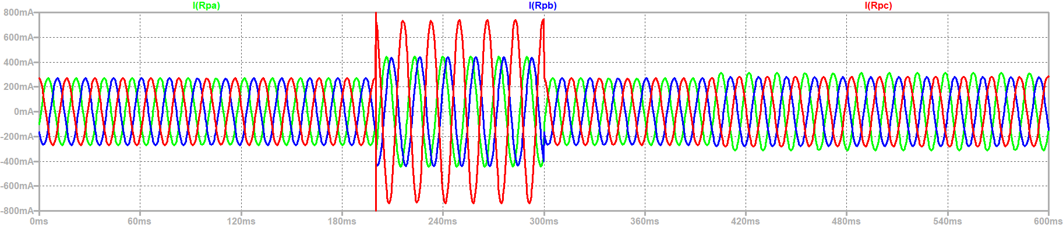
Line currents into the wye load and into primary not balanced with unbalanced load
Current into
Wye load
Ground Fault
Unbalanced Load
Primary currents not extremely large during ground fault – may not trip fault protection
Current into
Primary

Slide 9
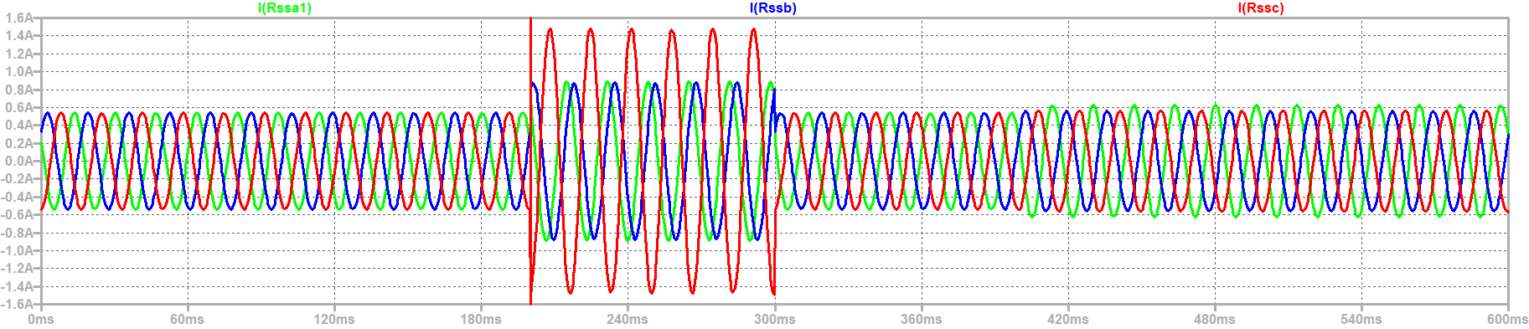
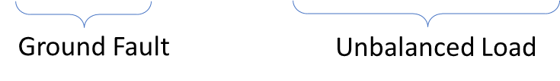
Line Currents out of Transformer
Secondary currents not extremely large during ground fault – may not trip fault protection

Slide 10
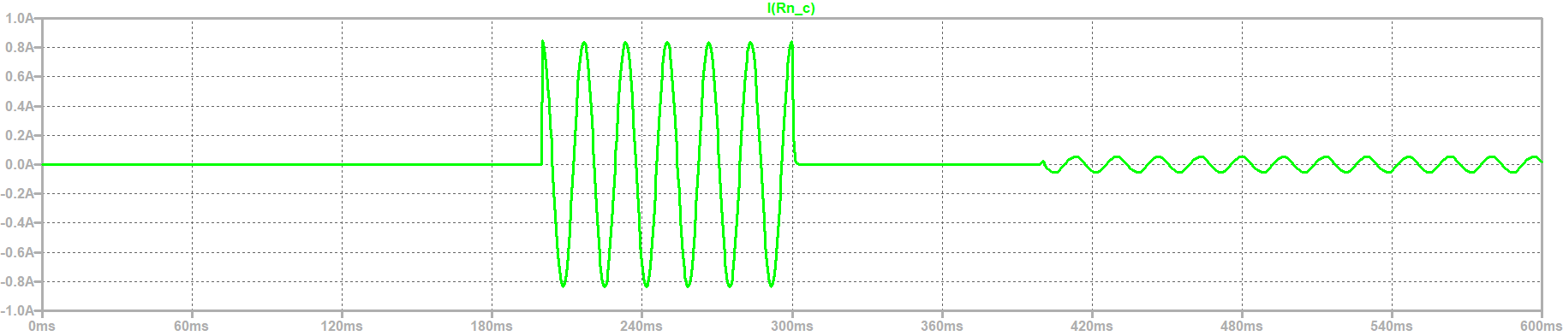
Ground faults and unbalanced load results in current in the Neutral Conductor
Ground Fault
Unbalanced Load

Slide 11
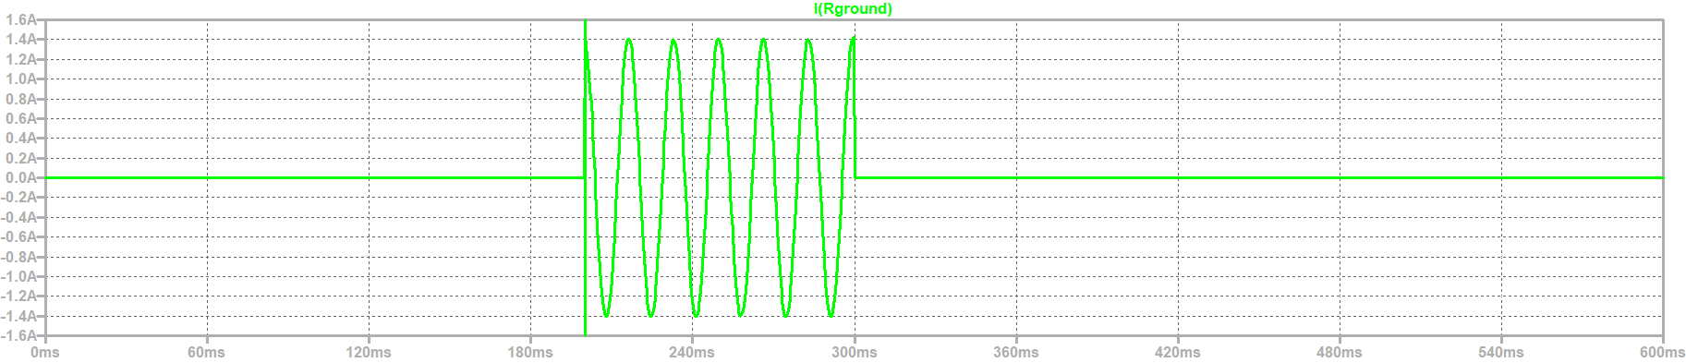
Ground Fault Currents
Ground Fault
Ground fault current may not be
Sufficient to trip breakers

Slide 12
Wrap Up

